Slide 1
Why Data Science is so popular?
Premanand S

Slide 2
Clarity before Swim – What’s the difference between?
Artificial Intelligence
Machine Learning
Deep Learning
Data Science
Data Analytics

Slide 3
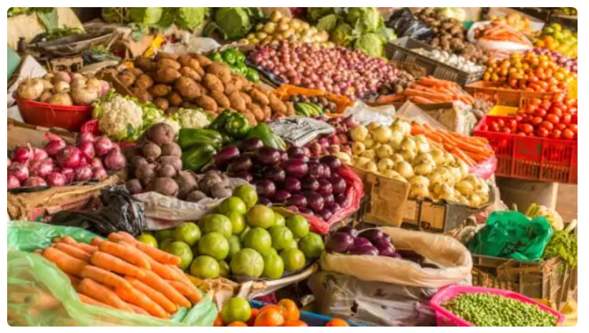
Data – Layman understanding

Slide 4
DATA
Signal – Information
Source – Smart Phone, Laptop, Smart watches, Smart devices, Sensors etc…
Types – Images, Audio, Text, Video etc…
Application – Communication, Social Media, E-Commerce, Sports, Groceries, News, Entertainment etc…

Slide 5
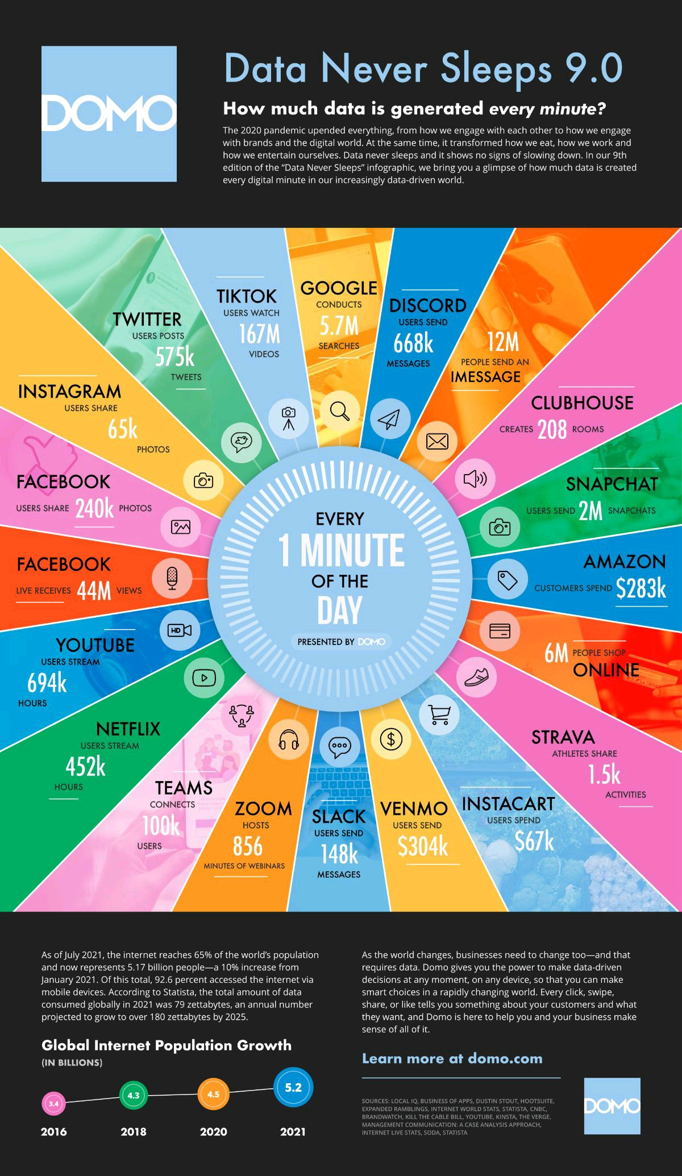
So from where these DATAs? (our daily use)

Slide 6
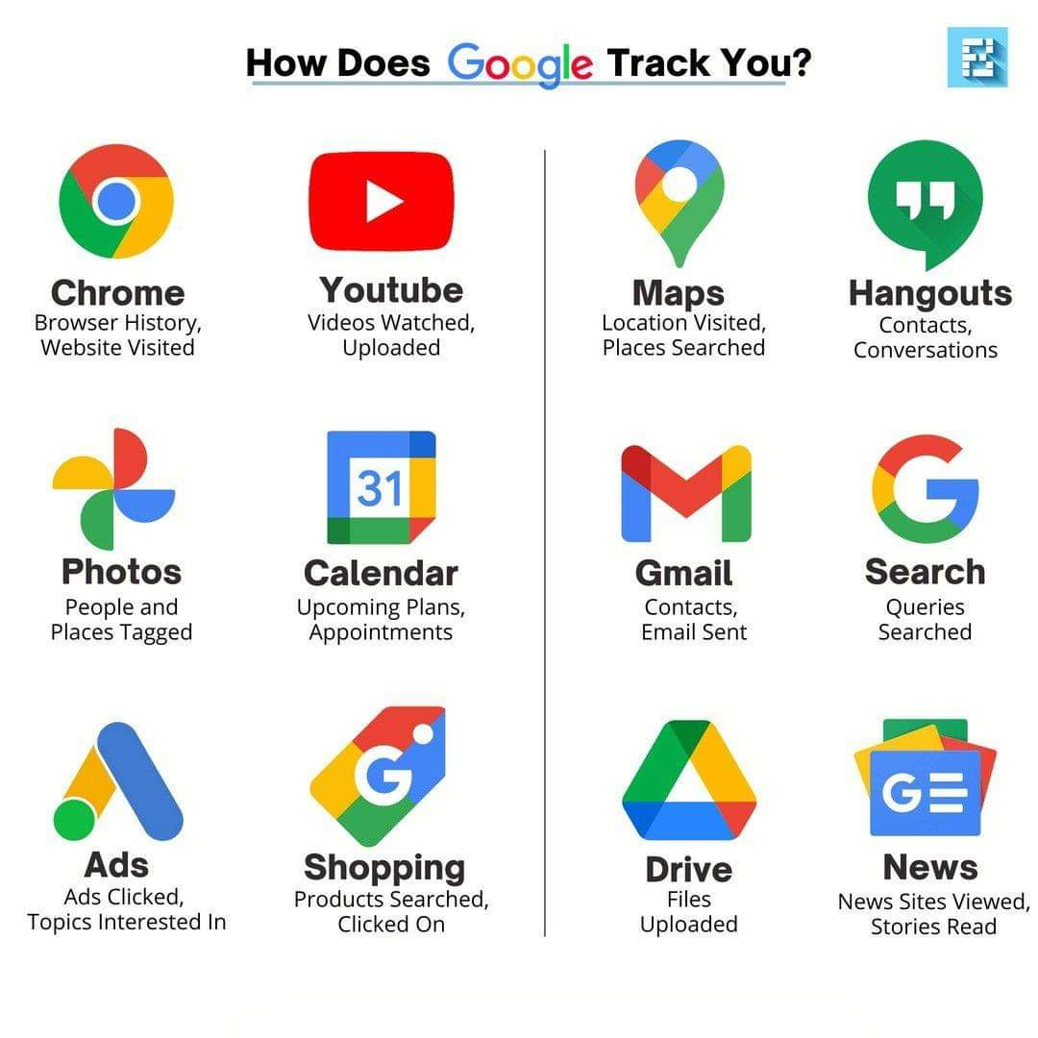
Data - For instance, let’s Google it with smart

Slide 7
Some of the job description related to DS
Data Engineer
Decision Maker
Analyst
Expert Analyst
Statistician
Applied ML Engineer
Data Scientist
Analytics Manager
Qualitative Expert
Researcher
Domain Expert & many more…

Slide 8
What we need to learn for Data Science domain?
Programming Language: Python, R, Julia, SQL
Platform (IDE): Anaconda, Pycharm
Tools: Excel, Matlab, Weka
Visualization: Power BI, Tableau
Maths: Statistics, Calculus, Probability, Linear Algebra

